Slide 1
Employee Data analysis using Excel
Presented By - N.SoBANA SREE
Register No. - B0C2C8B1AA22EF79F93447727AB637E3
Department - Department of commerce Honours
College - Sri Kanyaka Parameswari Arts & Science College For Women

Slide 2
Project title
Impact of remote work on employee productivity

Slide 3
Agenda
1.Problem Statement 2.Project Overview 3.End Users 4.Our Solution and Proposition 5.Dataset Description 6.Modelling Approach 7.Results and Discussion 8.Conclusion

Slide 4
Problem Statement
The shift to remote work has become increasingly common. This project aims to investigate how remote work influences employee productivity, including potential benefits and challenges. Understanding these effects is crucial for organizations to make informed decisions about work arrangements.

Slide 5
Project Overview
The project will analyze various factors impacting productivity in remote work environments compared to traditional office settings. This will involve collecting and analyzing data on employee performance, engagement, and work-life balance to assess how remote work affects productivity.

Slide 6
End Users
Businesses and Employers: To make informed decisions about remote work policies.
HR Departments: To develop effective remote work strategies and support systems.
Employees: To understand the implications of remote work on their productivity and work-life balance.
Researchers: To contribute to academic literature on remote work and productivity.

Slide 7
Solution and Proposition
The solution involves a comprehensive analysis of productivity metrics in remote versus in-office settings. The proposition includes: Data Collection : Gathering data on performance metrics, employee satisfaction, and work output. Comparative Analysis : Comparing productivity metrics between remote and office workers. Recommendations : Providing actionable insights and recommendations based on findings to optimize remote work practices.

Slide 8
Dataset Description
Employee Performance Metrics: Data on work output, task completion rates, and productivity measures. Employee Satisfaction Surveys: Feedback on job satisfaction, work-life balance, and remote work experience.
Work Environment Variables : Information on home office setups, communication tools used, and work schedules.
Demographic Information : Age, role, industry, and experience level of employees.

Slide 9
Modelling Approach
Data Preprocessing : Cleaning and preparing the data for analysis, including handling missing values and normalization.
Exploratory Data Analysis (EDA) : Identifying patterns and correlations in the data.
Statistical Analysis : Using statistical tests to determine significant differences in productivity between remote and in-office work.
Machine Learning Models: Implementing models to predict productivity based on various factors (if applicable).
Comparative Analysis: Evaluating productivity trends and patterns in both remote and office environments.

Slide 10
Results and Discussion
Findings: Summarize key insights regarding the impact of remote work on productivity.
Comparison : Discuss differences observed between remote and in-office productivity.
Factors Influencing Productivity : Highlight factors that significantly affect productivity in remote work settings.
Challenges and Benefits : Discuss the challenges faced and benefits observed in remote work scenarios.

Slide 11
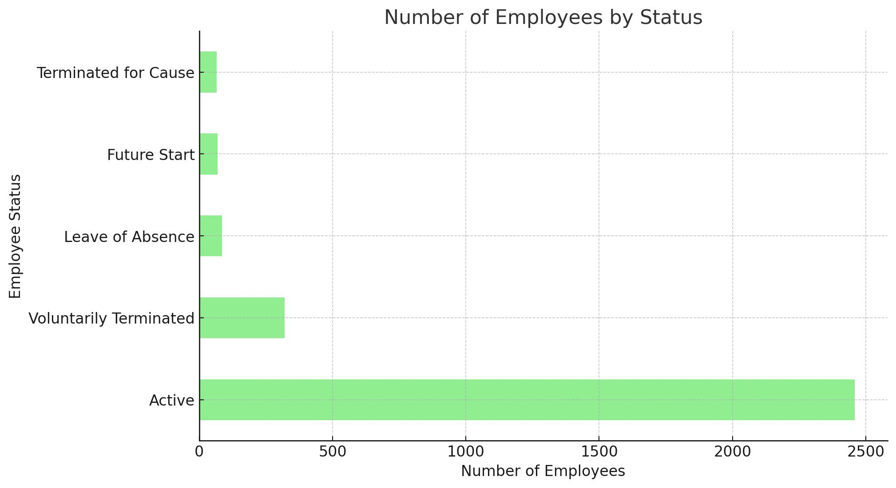

Slide 12
Conclusion
Summary : Recap the main findings and their implications for remote work policies.
Recommendations: Offer practical recommendations for businesses to enhance productivity in remote work environments.
Future Research : Suggest areas for further research to deepen the understanding of remote work's impact on productivity.

